Slide 1


Hamid Heritage
Building on Trust, Shaping the Future
123 Anywhere St., Any City
LIVE DATA, SMARTER DECISIONS: PORTFOLIO STOCK PERFORMANCE ANALYTICS
BY Karthik Kovuri
BA student project

Slide 2


PROBLEM STATEMENT
The primary objective of this project is to analyze stock performance trends and portfolio metrics to understand market behavior and the profitability of specific investments. By visualizing daily price changes and portfolio holdings, this analysis aims to provide insights into stock volatility, performance over time, and investment growth.
BA student project

Slide 3


DATA SET
Historical Stock Data
Stock Portfolio Data
BA student project

Slide 4

PROJECT SCOPE
This project focuses on analyzing stock performance and portfolio metrics through data visualization to support strategic investment decisions.
BA student project

Slide 5

SIGNIFICANCE OF THE STUDY
This analysis provides investors and financial analysts with actionable insights into stock market behavior, enabling them to evaluate investment performance and make informed portfolio adjustments.
BA STUDENT PROJECT

Slide 6
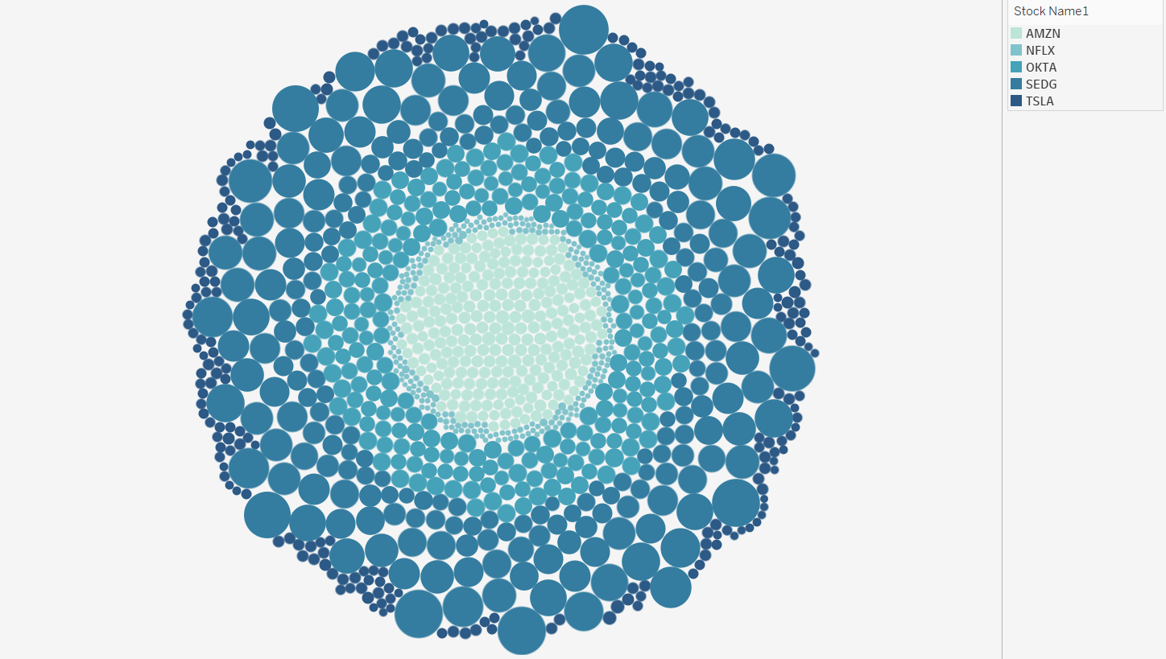
DAYS WITH HIGH/LOW VOLATILITY
Larger circles represent days with higher volatility. The distribution of circle sizes provides a quick glance at the frequency of high or low volatility days.
High-volatility days might correspond to significant movements in specific stocks, such as SolarEdge Technologies, which could help inform risk management strategies.
BA student project

Slide 7

STOCK PERFORMANCE DASHBOARD
The purpose is to provide a summary of portfolio performance,the mertics displayed are Total portfolio value, returns, and key insights.
BA student project

Slide 8
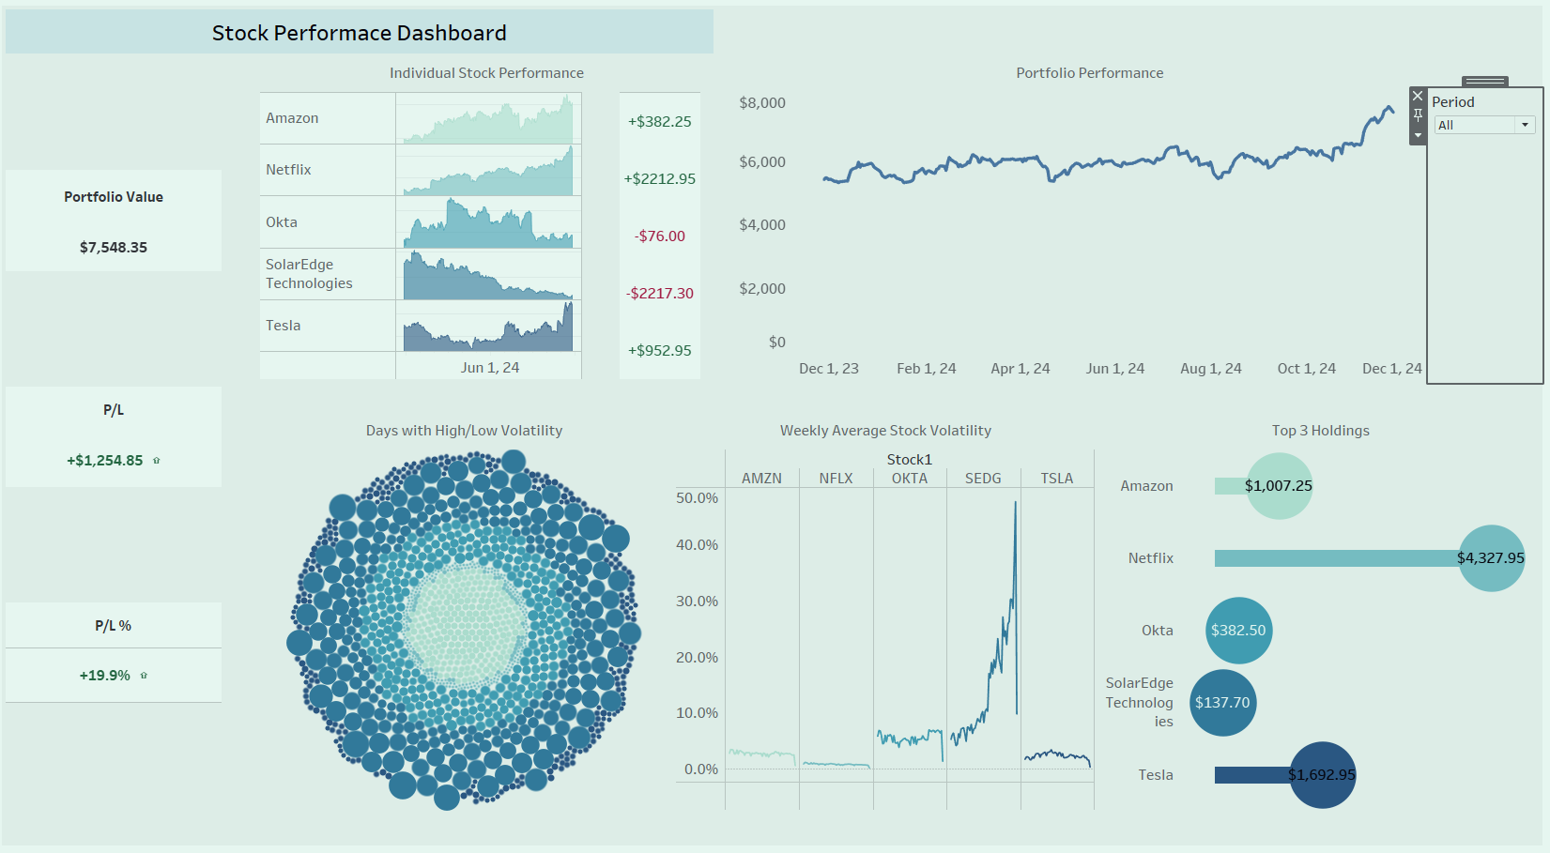
BA students project

Slide 9

ANALYSIS USING KNIME
A custom workflow, steps including data ingestion, aggregation, merging, and output generation.
BA student project

Slide 10
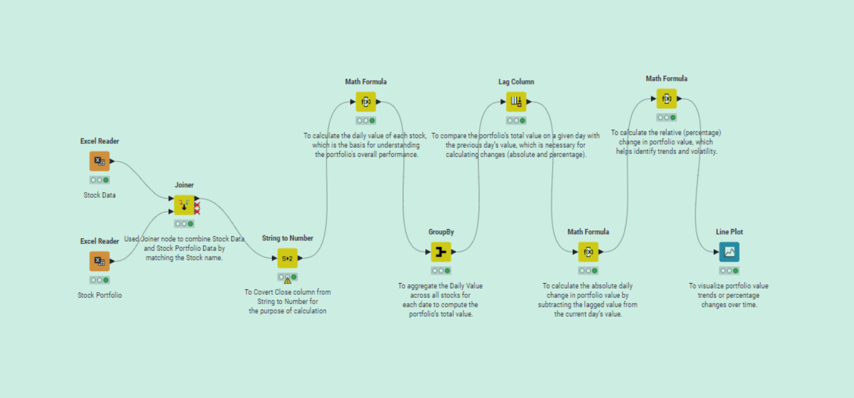

BA student project

Slide 11

Hamid Heritage
Building on Trust, Shaping the Future
123 Anywhere St., Any City
THANK
YOU
BA student project

